Slide 1

SEMINAR
ON
Deepfake Video Detection Using Neural Network
Presented by
Pranay V. Shahare
Tejaswini V. Hirudkar
M.Sc. - Semester IV (Computer Science)
Under the guidance of
Dr. S. R. Gedam
Assistant Professor
DEPARTMENT OF COMPUTER SCIENCE
Shri Shivaji Education Society Amravati’s,
SCIENCE COLLEGE
Congress Nagar, Nagpur-440012.
2021-22

Slide 2
Introduction
Results
01
06
Objective
Conclusion
07
02
Methodology
Future Scope
03
08
Model Architecture
Tools and Technologies
04
09
Data Exploration
10
Reference
05

Slide 3
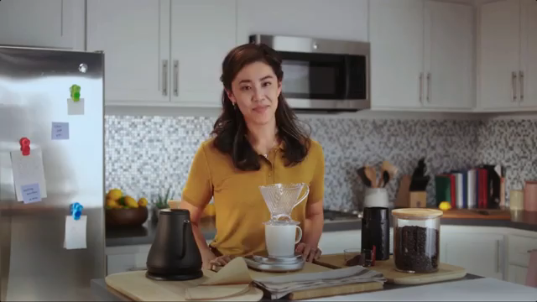
Introduction
Deep fake is a technique for human image synthesis based on artificial intelligence.
Deep fakes are created by combing and superimposing existing images and videos onto source images or videos using a deep learning technique known as generative adversarial network.

Slide 4
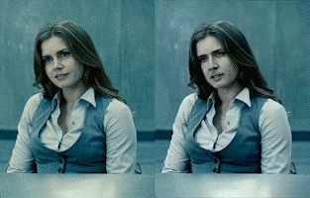
Objective
1. To create deepfake video using available applications (Zao, Deep Art, Wombo).
2. To detect a deepfake video using neural network.

Slide 5
Methodology
As deep fakes are spreading faster than expected and creating very serious issues; it’s necessary to have automatic tools and technologies to detect fake content.
Deep Fake Creation
Architecture
Dataset
Pre-Processing
CNN
The flow of methodology to be applied is :-
LSTM

Slide 6
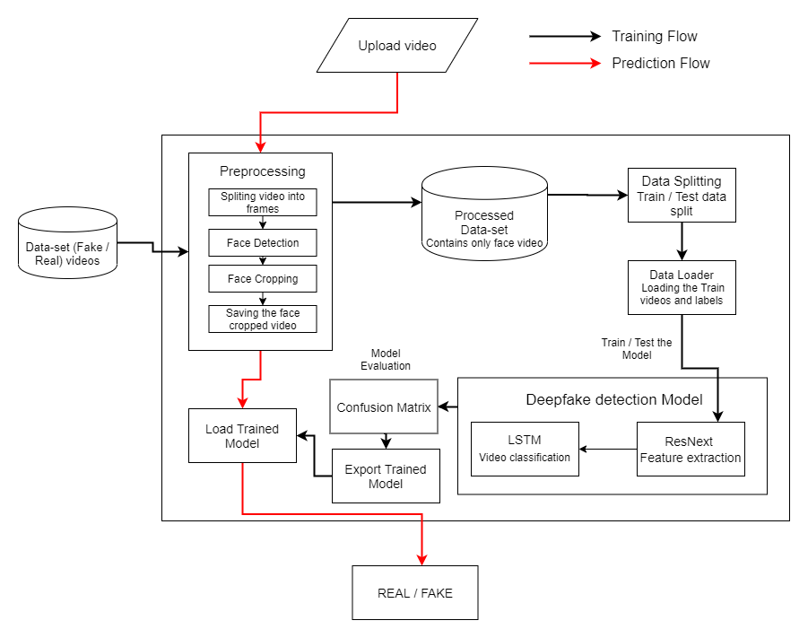

System Architecture

Slide 7
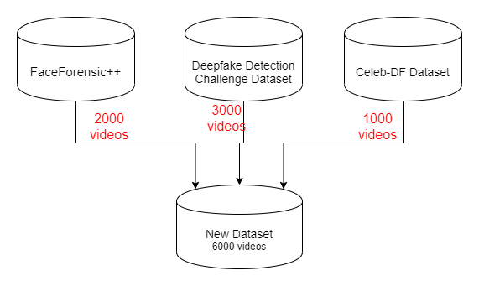
Data-set Exploration

Slide 8
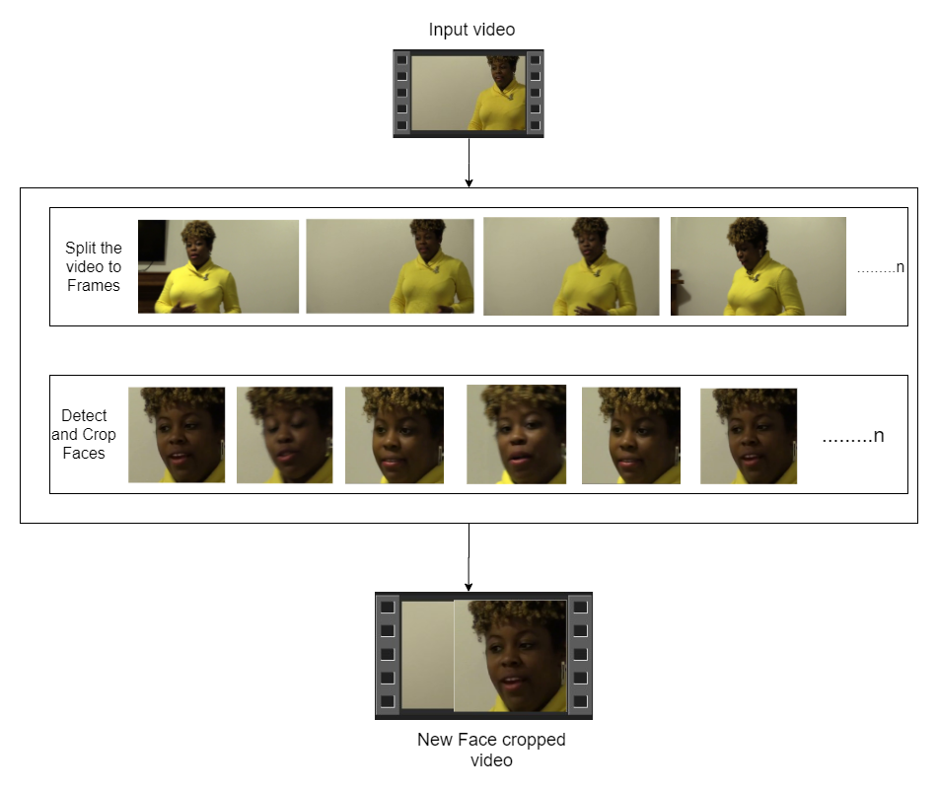

Pre-processing
SPLIT VIDEO INTO FRAMES
FACE DETECTION
5
4
3
2
1
CROPING FACE
CREATING NEW FACE CROPPED VIDEO
SAVING THE FACE CROPPED VIDEO

Slide 9
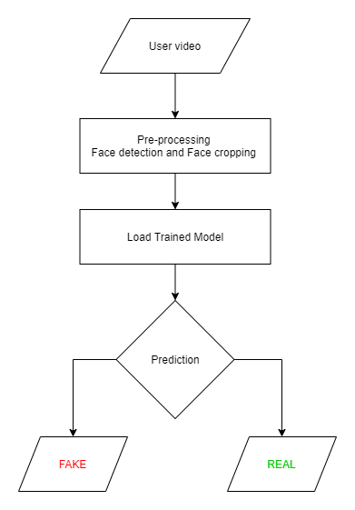
Prediction Workflow

Slide 10
Results
Model Name | Dataset | No. of Videos | Sequence Length | Accuracy
model_90_acc_20_frames_FF_data | FaceForensic++ | 2000 | 20 | 90.95477387
model_95_acc_40_frames_FF_data |  |  | 40 | 95.22613065
model_97_acc_60_frames_FF_data |  |  | 60 | 97.48743719
model_97_acc_80_frames_FF_data |  |  | 80 | 97.73366834
model_97_acc_100_frames_FF_data |  |  | 100 | 97.76180905
model_84_acc_10_frames_final_data | Our Dataset | 6000 | 10 | 84. 662519
model_87_acc_20_frames_final_data |  |  | 20 | 87.79160186
model_89_acc_40_frames_final_data |  |  | 40 | 89.3468118195956
model_91_acc_60_frames_final_data |  |  | 60 | 91.5909797822706
model_92_acc_80_frames_final_data |  |  | 80 | 92.4981855883877
model_93_acc_100_frames_final_data |  |  | 100 | 92.10883877

Slide 11
Conclusion
We presented a neural network-based approach to classify the video as deep fake or real, along with the confidence of proposed model. The proposed method is inspired by the way the deep fakes are created by the GANs with the help of Autoencoders. Our method does the frame level detection using ResNext CNN and video classification using RNN along with LSTM. We believe that, it will provide a very high accuracy on real time data.

Slide 12
Future Scope
Our method has not considered the audio. That’s why our method will not be able to detect the audio deep fake. But we are proposing to achieve the detection of the audio deep fakes in the future.

Slide 13














Programming Languages
Python3
JavaScript
Programming Frameworks
PyTorch
Django
Tools and Technologies
IDE
Google
Jupyter Notebook
Visual Studio Code
Cloud Services
Google Cloud Platform
Version Control
Git

Slide 14


